Slide 1
Train Ticket Booking System
By : Praveen Kumar E

Slide 2
Overview
This project is a Python-based console application that allows users to book train tickets easily.
It displays available trains, routes, and prices, and lets users search and book tickets through a simple menu-driven system.

Slide 3
OBJECTIVES

Slide 4
To simplify the process of train ticket booking using Python.
To provide users with an easy interface to view and select trains.
To implement data handling using Python lists and dictionaries.
To calculate total fare automatically based on selected train and number of tickets.

Slide 5
TECHNOLOGIES USED

Slide 6
Python (Core + OOP + Functions)
We used inputs handling for collects users data.
Modules helps to access multiple files.
Conditional Statements
Loops Statements
Datetime and Re Modules imported

Slide 7
SYSTEM ARCHITECTURE

Slide 8
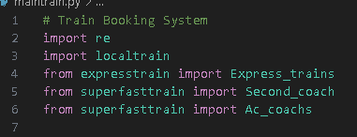
Main Module: Controls the system, connects all modules.
Local Train Module: Handles local bookings.
Express Train Module: Route-based pricing, multiple conditions.
Superfast Express Module: Long-distance booking, AC coach, slot system.
Verification Module: Verifies user inputs.
Ticket Printing Module: Generates final ticket.

Slide 9
WORKFLOW DIAGRAM

Slide 10
User
Main.py
Localtrain.py
Expresstrain.py
Superfastexpress.py
spfdata.py
Tickets
spfprice.py
spfprints.py

Slide 11
FEATURES

Slide 12
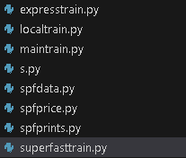
Modular design with 5 connected files.
Realistic train routes and price calculation.
Condition-based booking logic.
User verification and ticket generation.
OOPs and functions used for clean code structure.

Slide 13
OUTPUT

Slide 14
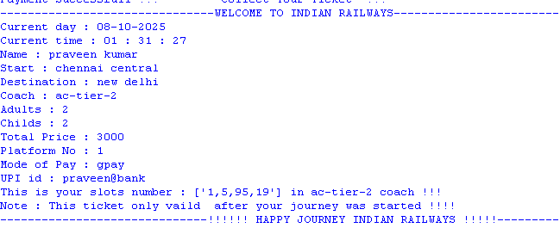
Final ticket displays user details and price.
Confirmation message after successful booking.

Slide 15
CONCLUSION

Slide 16
Demonstrates real-world train booking logic.
Showcases modular programming, OOPs, and condition-based logic.
Simplifies train booking efficiently.

Slide 17
THANK YOU

